Slide 1

Predicting the Billboard Top 100: Applying Machine Learning to Music Streaming Data
DSC288R Group 2
Lindsay Sager
Tiffany Tong

Slide 2
Agenda
Background
Literature Survey
Why Machine Learning
Dataset Overview
Feature Extraction
Details on Models Used
Results and Observations
Next Steps and Risks
References

Slide 3

Background
Objective of Our Research:
Predict whether a song has reached the Billboard Top 100 based exclusively on its audio features
Value to the Music Industry:
Tailoring music to audience preferences
Investment in music rights
Understanding trends

Slide 4

Literature Survey
What people tried to solve this problem:
Logistic Regression model
Decision trees
Random Forest
K-Nearest Neighbor
Support vector machines
Neural networks

Slide 5
Literature Survey (Cont.)
Takeaways from Literature Surveys:
Importance of data quality
Changing nature of music trends and public taste
Gaps to address:
The impact of release year on the popularity of a song
Adopt new algorithms or improve existing ones

Slide 6

Why Machine Learning
Machine Learning (ML) algorithms can identify complex patterns in large datasets.
Song features can be numerous, subtle, and even abstract, such as "danceability" or "energy".

Slide 7
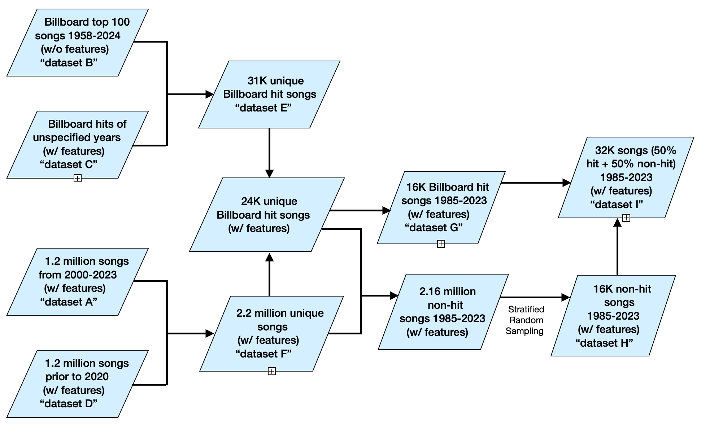
Dataset Overview
Source Data:
Source of truth for Billboard Top 100
Billboard data w/ audio features
1.2M songs w/ audio features
1M songs w/ audio features

Slide 8
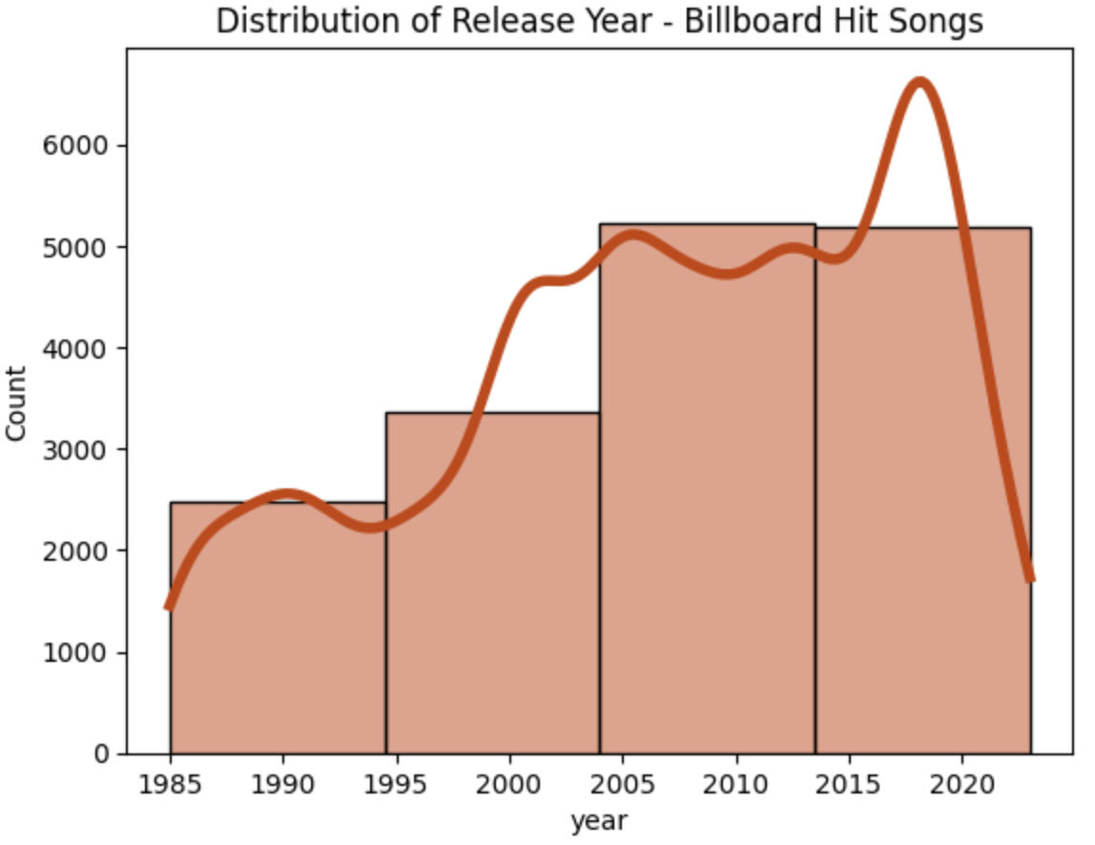
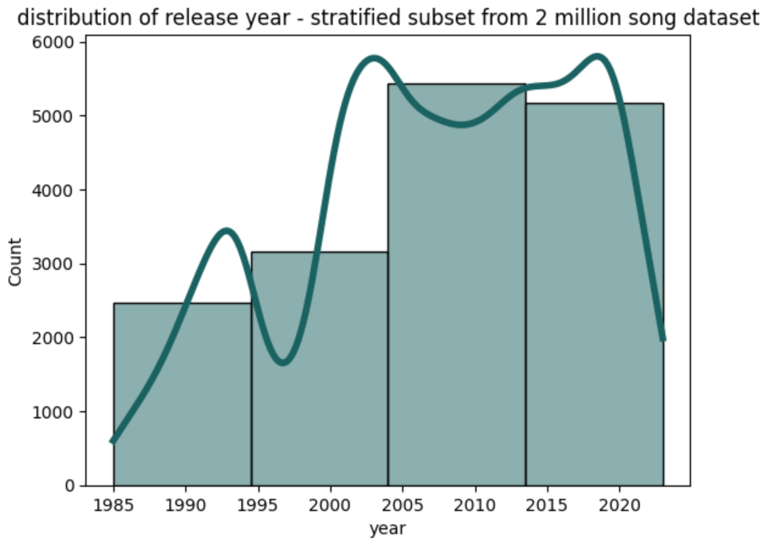
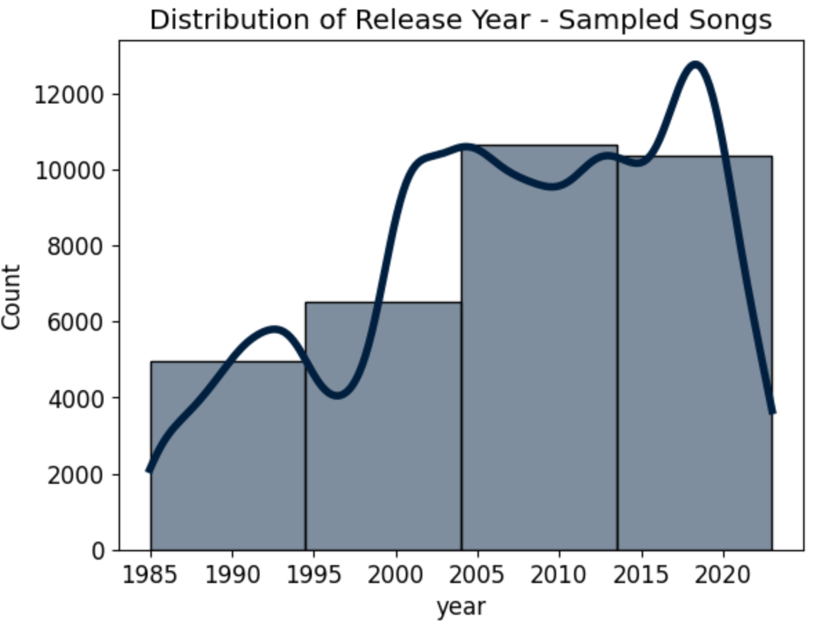
Dataset Overview (Cont.)
16,242 hit songs w/ features
(1985-2023)
16,242 non-hit songs w/ features
(1985-2023)
32,484 songs w/ features
(1985-2023)

Slide 9
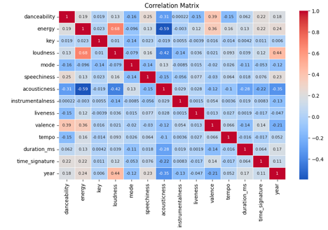
Feature Extraction and EDA
Correlation of the Features:
Energy and Loudness are highly positively correlated
Acousticness is negatively correlated with Energy and loudness

Slide 10
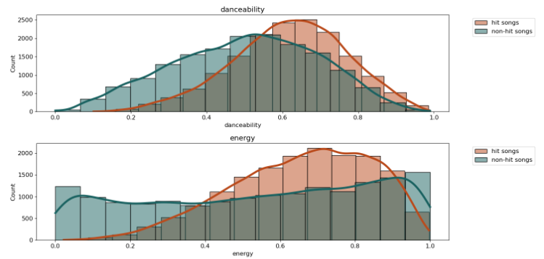
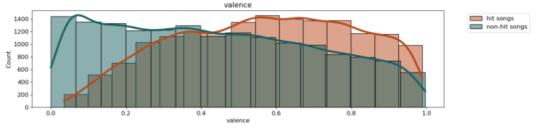
Feature Extraction and EDA
High Priority Features:
Danceability - Top 100 slight peak shift to the right, differentiated trend from non-hits
Energy - Top 100 larger peak shifted right while non-hits are more evenly distributed
Valence - Top 100 and non-hits essentially have opposite distributions/peaks with hit songs trending to the right. There is a lot of overlap here though

Slide 11
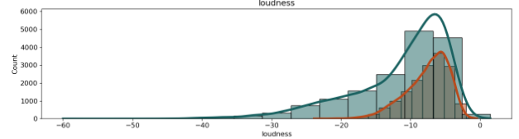
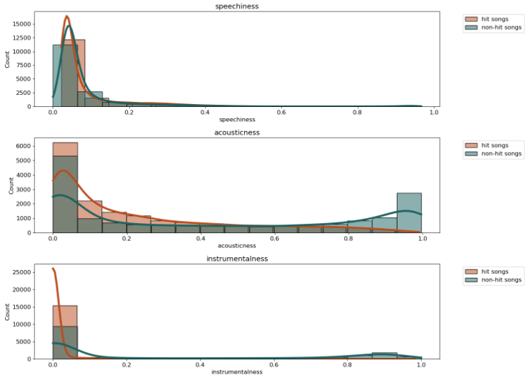
Feature Extraction and EDA (Cont.)
Mid-Priority Features:
Danceability - Top 100 slight peak shift to the right, differentiated trend from non-hits
Loudness - Top 100 much tighter range compared to non-hits, not primary focus but could be good addition
Speechiness - Top 100 is very tight lower range, non-hits also skew lower but have a bit more distribution, not primary focus but could be good add-on feature
Acousticness - non-hits have strong peak towards upper range
Instrumentalness - Top 100 all at low end, literally no variation. non-hits also favor low end but has an overall wider distribution of values

Slide 12
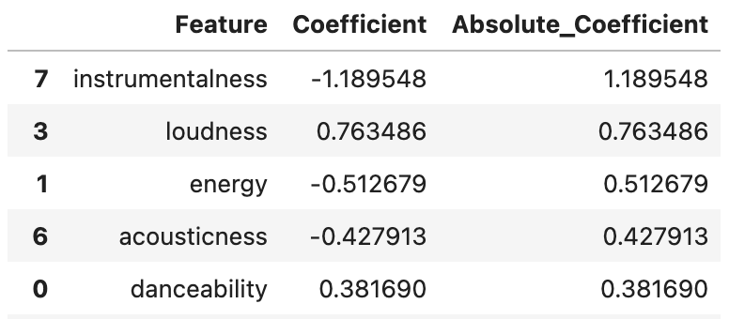
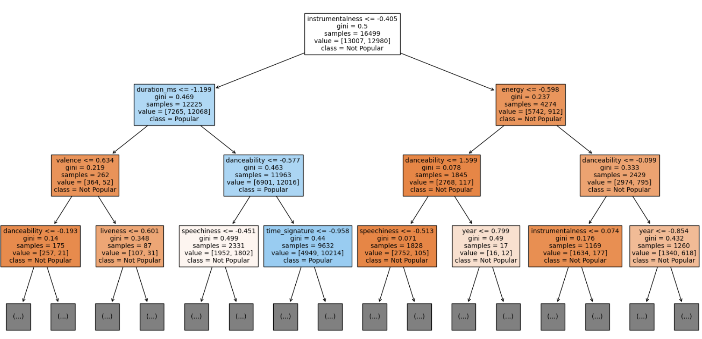
Details on Models Used
Logistic Regression (LR)
LR model training:
Used all the features in the dataset
Extracted the coefficients of each feature*
Feature concentration check:
Retrained the model using the 5 features with the highest absolute values of coefficients
Random Forest (RF)
RF model training:
Used all the features in the dataset
Single decision tree plot**
Feature importance check
Hyperparameter tuning:
Randomized Search with Cross-Validation
* Top 5 features w/ the highest absolute values of coefficients
** One single decision tree

Slide 13
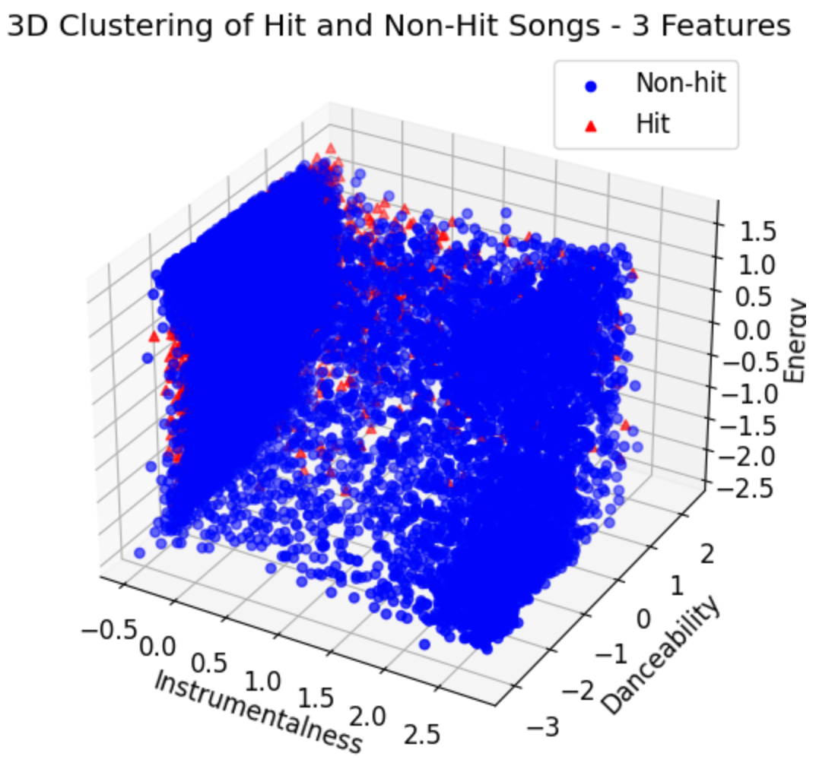
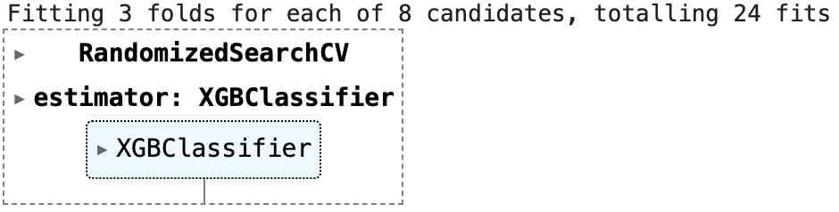
Details on Models Used (Cont.)
K-Nearest Neighbors (KNN)
LR model training:
Used all the features in the dataset
3D clustering of hit and non-hit songs*
Selected three features w/ high importance and low collinearity
XGBoost
XGBoost model training:
Used all the features in the dataset
Hyperparameter tuning**:
Randomized Search with Cross-Validation
Feature importance check
Learning curve plot
** Hyperparameter tuning using RandomizedSearchCV
* 3D clustering of hit and non-hit songs

Slide 14
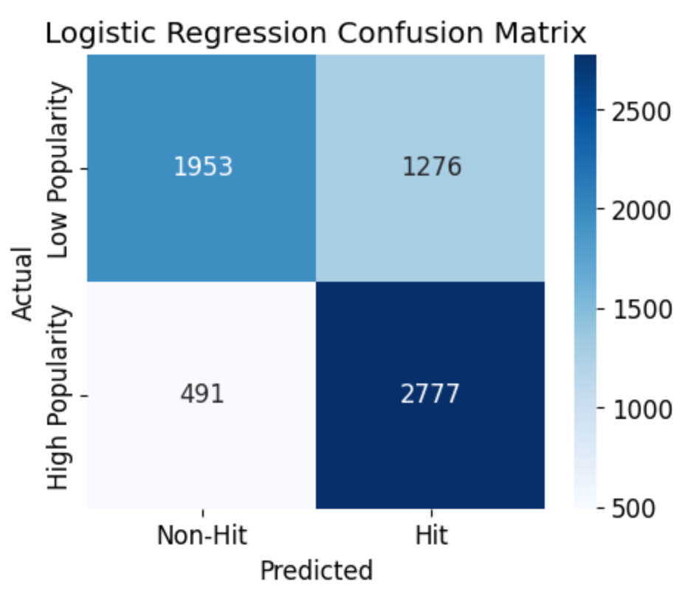
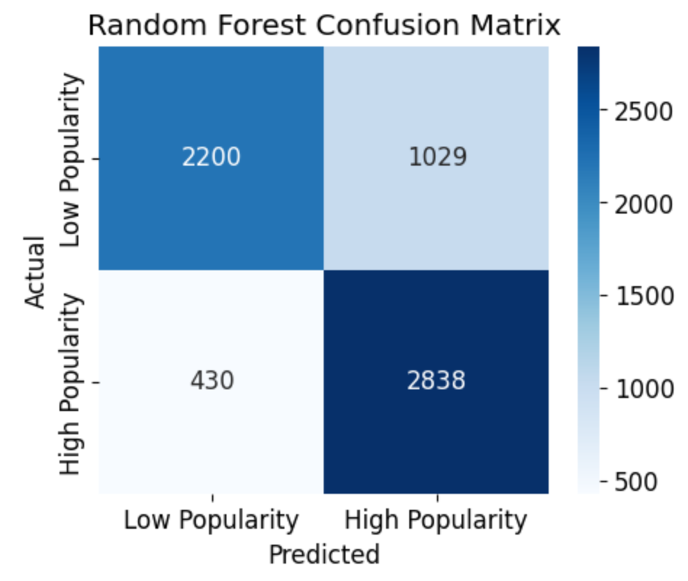
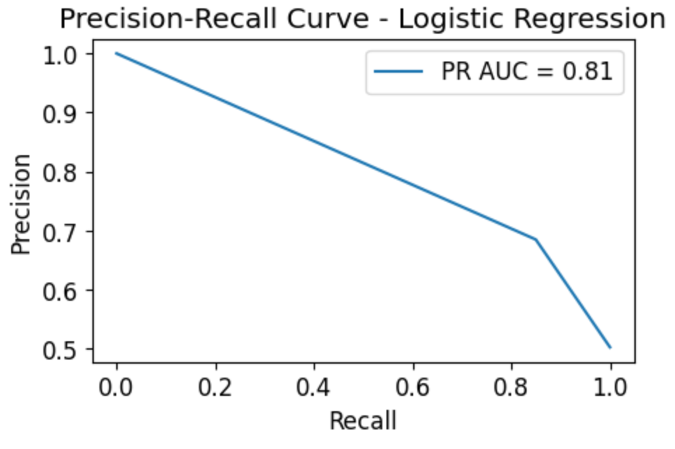
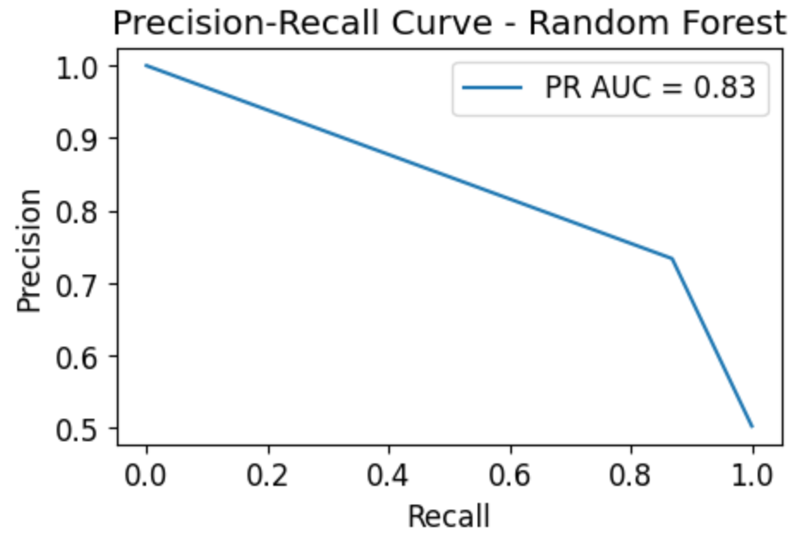
Results and Observations
Logistic Regression (LR)
Accuracy
Initial model: ~ 72.74%
Retrained model: ~ 71.60%
Performance of initial model
Confusion Matrix
Precision and Recall
Random Forest (RF)
Accuracy
Initial model: ~ 77.16%
Optimized model: ~ 77.25%
Performance of optimized model
Confusion Matrix
Precision and Recall
Learning Curve Plot

Slide 15
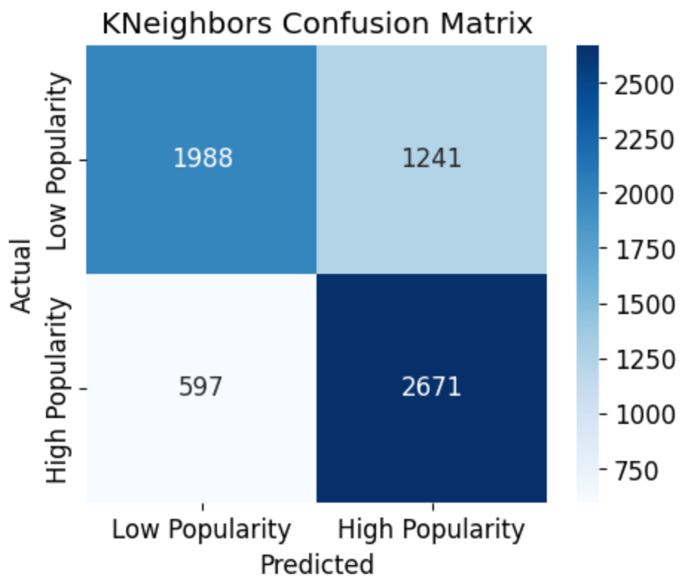
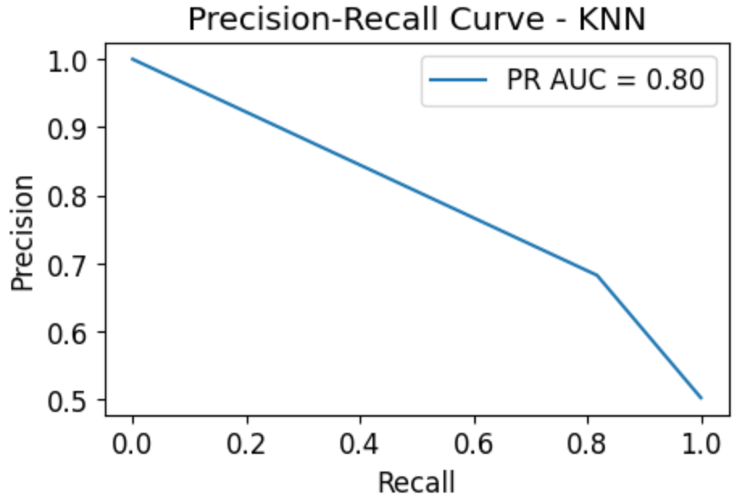
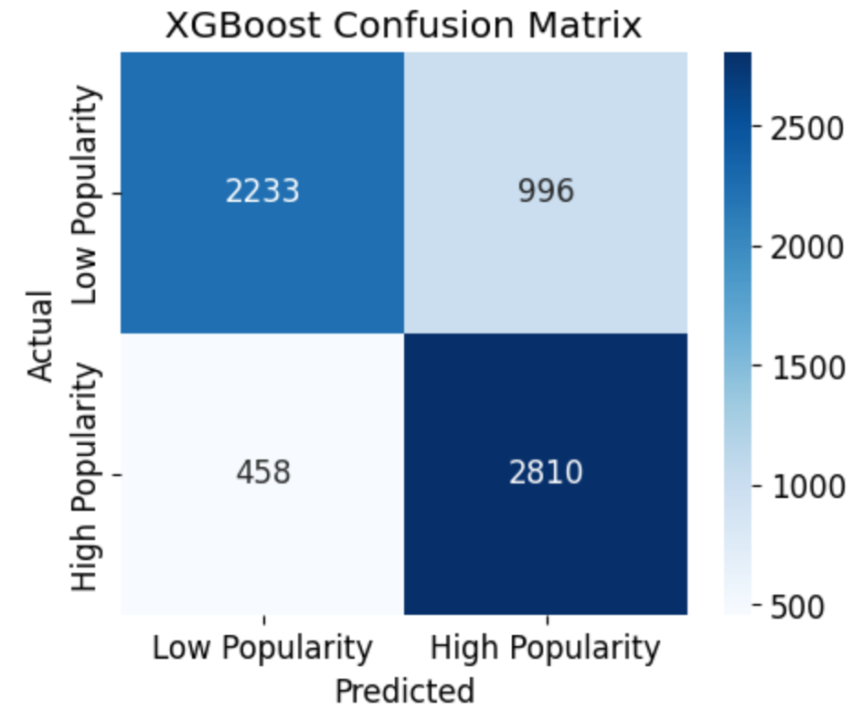
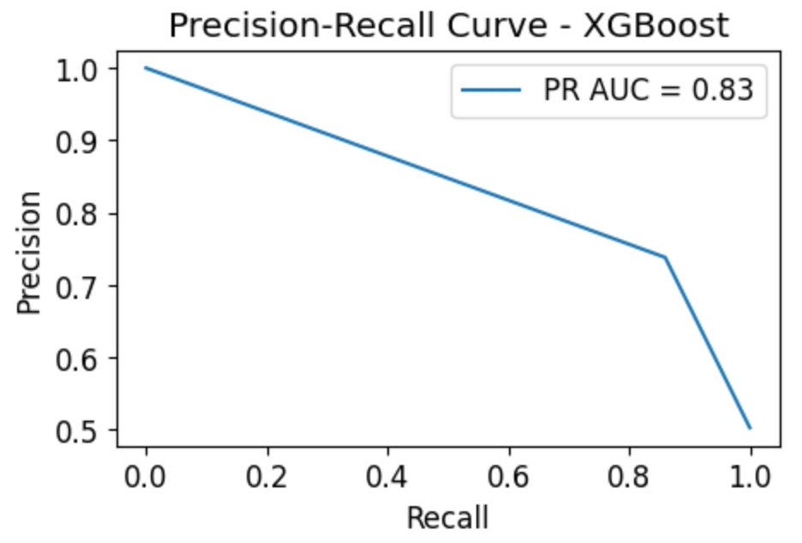
Results and Observations (Cont.)
K-Nearest Neighbors (KNN)
Accuracy
~ 72.52%
Performance
Confusion Matrix
Precision and Recall
XGBoost
Accuracy
Initial model: ~ 77.17%
Optimized model: ~ 78.08% (Highest)
Performance of optimized model
Confusion Matrix
Precision and Recall
Learning Curve Plot (see slide 16)

Slide 16
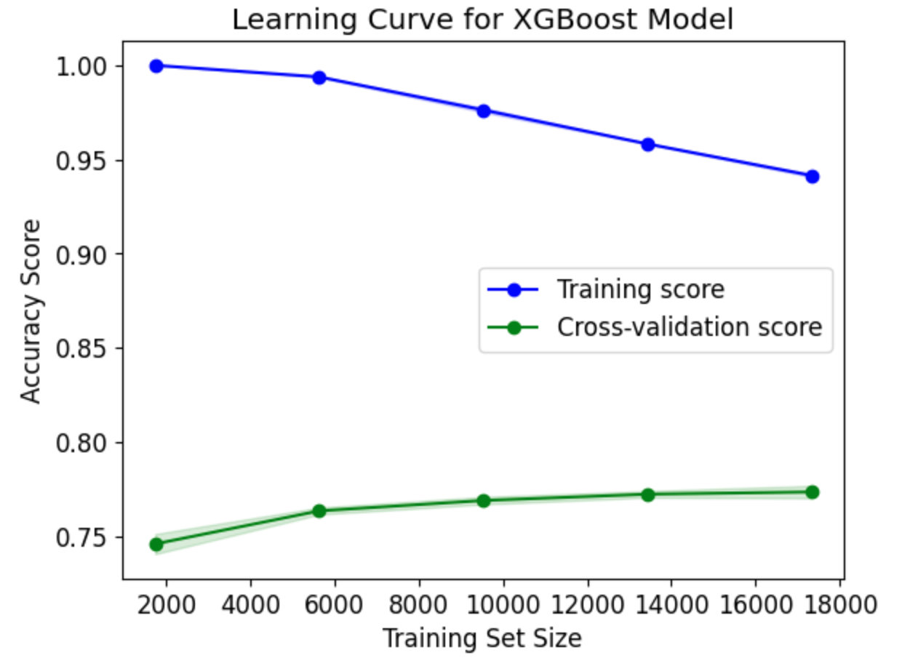
Results and Observations (Cont.)
Learning Curve of the Optimized XGBoost Model
Limitation:
A complex model requires a larger amount of data to start generalizing well.
The training score and the cross-validation score have a trend to converge if more training data is available, which indicates the model may generalize better with a larger dataset.

Slide 17

Next Steps and risks
Try the other models
Neural Networks
Unsupervised clustering for feature engineering
Risks:
Model overfitting
Computational efficiency

Slide 18
References
Amitansh Joshi, Amit Parolkar, Vedant Das. (2023). Spotify_1Million_Tracks [Data set]. Kaggle. https://doi.org/10.34740/KAGGLE/DSV/59878
T. Li, M. Choi, K. Fu and L. Lin, "Music Sequence Prediction with Mixture Hidden Markov Models," 2019 IEEE International Conference on Big Data (Big Data), Los Angeles, CA, USA, 2019, pp. 6128-6132, doi: 10.1109/BigData47090.2019.9005695.
Dhruvil Dave. (2021). Billboard "The Hot 100" Songs [Data set]. Kaggle. https://doi.org/10.34740/KAGGLE/DS/1211465
Dimolitsas, Ioannis & Kantarelis, Spyridon & Fouka, Afroditi. (2023). SpotHitPy: A Study For ML-Based Song Hit Prediction Using Spotify.
Figueroa Rodolfo. (2023). Spotify 1.2M+ Songs [Data set]. Kaggle. Spotify 1.2M+ Songs (kaggle.com)
D. Herremans, Martens, D., and Sörensen, K., “Dance hit song prediction”, Journal of New music Research, vol. 43, no. 3, p. 302, 2014.
Ioannis Karydis, Aggelos Gkiokas, Vassilis Katsouros. Musical Track Popularity Mining Dataset. 12th IFIP International Conference on Artificial Intelligence Applications and Innovations (AIAI), Sep 2016, Thessaloniki, Greece. pp.562-572, ⟨10.1007/978-3-319-44944-9_50⟩. ⟨hal-01557622⟩
Middlebrook, Kai & Sheik, Kian. (2019). Song Hit Prediction: Predicting Billboard Hits Using Spotify Data.
Miller Sean. (2021) Billboard Hot weekly charts [Data set]. Data World, Kaggle. Billboard Hot weekly charts - dataset by kcmillersean | data.world
Ni, Y., Santos-Rodriguez, R., Mcvicar, R., De Bie, T.: Hit song science once again a science. In: 4th International Workshop on Machine Learning and Music (2011)
Pachet, F. (2011) Hit Song Science. In Tao, Tzanetakis & Ogihara, editor, Music Data Mining, CRC Press/Chapman Hall
Pachet, F. and Roy, P. (2008) Hit Song Science is Not Yet a Science. Proceedings of Ismir 2008, pages 355-360, Philadelphia, USA
A. H. Raza and K. Nanath, "Predicting a Hit Song with Machine Learning: Is there an apriori secret formula?," 2020 International Conference on Data Science, Artificial Intelligence, and Business Analytics (DATABIA), Medan, Indonesia, 2020, pp. 111-116, doi: 10.1109/DATABIA50434.2020.9190613.
Spotify. Spotify for Developers. Retrieved January 19, 2024, from https://developer.spotify.com/documentation/
L. -C. Yang, S. -Y. Chou, J. -Y. Liu, Y. -H. Yang and Y. -A. Chen, "Revisiting the problem of audio-based hit song prediction using convolutional neural networks," 2017 IEEE International Conference on Acoustics, Speech and Signal Processing (ICASSP), New Orleans, LA, USA, 2017, pp. 621-625, doi: 10.1109/ICASSP.2017.7952230.
Zhao, M., Harvey, M., Cameron, D., Hopfgartner, F., Gillet, V.J. (2023). An Analysis of Classification Approaches for Hit Song Prediction Using Engineered Metadata Features with Lyrics and Audio Features. In: Sserwanga, I., et al. Information for a Better World: Normality, Virtuality, Physicality, Inclusivity. iConference 2023. Lecture Notes in Computer Science, vol 13971. Springer, Cham. https://doi.org/10.1007/978-3-031-28035-1_21

